Slide 1

UNIT-4

Slide 2
Searching Methods:
  Linear Search
  Binary Search
Sorting Techniques:
  Bubble Sort
  Selection Sort
  Insertion Sort
  Quick Sort
  Merge Sort

Slide 3
Searching and Sorting
Searching is the process of finding a particular element in an array.
Sorting is the process of rearranging the elements in an array so that they
are stored in some well-defined order.

Slide 4
Linear Search:
A linear or sequential search of an array begins at the beginning of the array
and continues until the item is found or the entire array has been searched.
  It is the basic searching technique.
  Very easy to implement
  The array DOESN’T have to be sorted.
  All array elements must be visited if the search fails.
  Could be very slow.

Slide 5
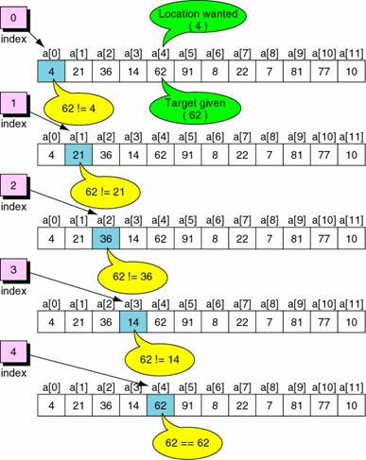
Example: Successful Linear Search

Slide 6
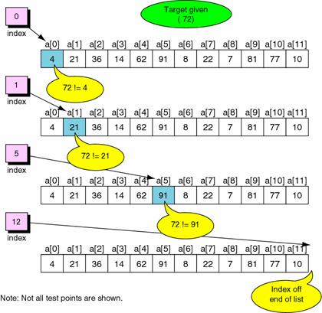
Example: Failed Linear Search

Slide 7
/* C program that use non recursive function to perform the Linear Search for a Key value in a given list of integers*/
#include<stdio.h> #include<conio.h> #define SIZE 8
int linear_search(int a[],int target,int size);
int main() {
int list[SIZE], target, index, i;
printf("\nEnter %d integer numbers separated by blanks: ",SIZE);
for(i = 0; i < SIZE; ++i)
scanf("%d", &list[i]);
printf("Enter an element to be searched: ");
scanf("%d", &target);
index = linear_search(list,target,SIZE);
if (index != -1)
printf("Target was found at index: %d ",index);
else
printf("Sorry, target item was not found");
getch();
return 0;
}

Slide 8
int linear_search(int a[],int target,int size)
{
int i=0,found = 0,loc;
while (!found && i < size)
{
if (a[i] = = target)
found = 1;
else
++i;
}
if(found)
loc = i;
else
loc = -1;
return loc;
}

Slide 9
/* C program that use recursive function to perform the Linear Search for a Key value in a given list of integers*/
#include<stdio.h> #define SIZE 5
int linearSearch(int array[], int index, int length, int value);
void main() {
int list[SIZE],element,i,target,index=0;
printf("\n\nEnter %d integer elements: ",SIZE);
for(i = 0; i < SIZE; i++) {
scanf("%d",&list[i]);
}
printf("\nEnter target element to be searched: ");
scanf("%d",&target);
element = linearSearch( list,index,SIZE,target);
if( element != -1 )
printf("\nElement is found at %d location ",element);
else
printf("Element is not found...");
getch();
}

Slide 10
int linearSearch(int array[], int index,int length, int value)
{
if(index>length-1)
return -1;
else
if (array[index]==value)
return index;
else
return linearSearch( array,index+1,length, value);
}

Slide 11
Binary Search: The search starts at the center of a sorted array, if center is equal to target element search is successful otherwise it determines which half to continue to search on that basis.
The algorithm starts searching with the mid element.
mid=(first + last)/2
  If the item is equal to mid then search is successful.
  If the item is less than the mid element, it starts over searching the first half of the list.
  If the item is greater than the mid element, it starts over searching the second half of the list.
  It then continues halving the list until the item is found.
Each iteration eliminates half of the remaining elements.
It is faster than the linear search.
It works only on SORTED array.
Thus, there is a performance penalty for sorting the array.

Slide 12
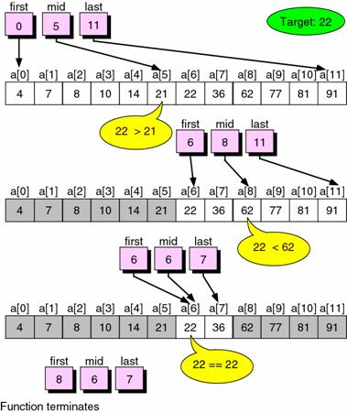
Example: Successful Binary Search

Slide 13
/* C program that use recursive function to perform the Binary Search for a Key value in a given list of integers*/
#include <stdio.h> #define SIZE 8
int binary_search (int list[], int low, int high, int target);
void main() {
int list[SIZE], target, index,i;
printf("Enter %d elements in ascending or descending order: ",SIZE);
for(i=0;i<SIZE;i++)
scanf("%d",&list[i]);
printf("Enter an element that is to be searched: ");
scanf("%d", &target);
index = binary_search(list, 0, SIZE-1, target);
if (index != -1)
printf("\nTarget was found at index: %d ", index);
else
printf("Sorry, target item was not found");
getch();
}

Slide 14
int binary_search (int list[], int low, int high, int target) {
int middle;
if (low > high)
return -1;
middle = (low + high)/2;
if (list[middle] == target)
return (middle);
else
if (list[middle] < target)
return binary_search(list,middle+1,high,target);
else
return binary_search(list,low,middle-1,target);
}

Slide 15
/* C program that use non recursive function to perform the Binary Search for a Key value in a given list of integers*/
#include <stdio.h> #define SIZE 8
int binary_search (int list[], int low, int high, int target);
void main() {
int list[SIZE], target, index,i;
printf("Enter %d elements in ascending or descending order: ",SIZE);
for(i=0;i<SIZE;i++)
scanf("%d",&list[i]);
printf("Enter an element that is to be searched: ");
scanf("%d", &target);
index = binary_search(list, 0, SIZE-1, target);
if (index != -1)
printf("\nTarget was found at index: %d ", index);
else
printf("Sorry, target item was not found");
getch();
}

Slide 16
int binary_search (int list[], int low, int high, int target) {
int mid,index;
while ( high >= low ) {
mid = ( low + high ) / 2;
if ( target < list[mid] )
high = mid - 1;
else
if ( target > list[mid] )
low = mid + 1;
else {
index=mid;
break;
}
}
if(index>high)
return -1;
else
return index;
}

Slide 17
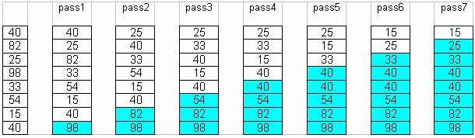
Bubble Sort Algorithm
The idea of Bubble (or exchange) sort is to scan through the list and swap each pair of adjacent elements that are in the wrong order.
The process is repeated each time from index zero to one less than the previous limit until either the list is exhausted or until a pass that involve no swap is encountered.
At the end of first pass, the largest element will move (or bubble up) to the end of the list.
At the end of the second swap, the second largest will move to its right place, etc.
The following table shows a trace of how bubble sort works.

Slide 18
Bubble sort
Suppose the following numbers are stored in an array: 32,51,27,85,66,23,13,57
Pass-1
32 51 27 85 66 23 13 57 no swap
32 27 51 85 66 23 13 57
32 27 51 85 66 23 13 57 no swap
32 27 51 66 85 23 13 57
32 27 51 66 23 85 13 57
32 27 51 66 23 13 85 57
32 27 51 66 23 13 57 85
Pass-2
27 32 51 66 23 13 57 85
27 32 51 66 23 13 57 85 no swap
27 32 51 66 23 13 57 85 no swap
27 32 51 23 66 13 57 85
27 32 51 23 13 66 57 85
27 32 51 23 13 57 66 85
and so on…

Slide 19
/* Write a c program to implement the bubble sort */
#include<stdio.h>
void BubbleSort(int a[],int index,int size);
void main() {
int n,a[10],i;
printf("\n\nEnter the size of array: ");
scanf("%d",&n);
printf("\n\nEnter the elements: ");
for(i=0;i<n;i++)
scanf("%d",&a[i]);
printf("\n\nElements before sorting: ");
for(i=0;i<n;i++)
printf(" %d",a[i]);
printf("\n");
BubbleSort(a,0,n);
getch();
}

Slide 20
void BubbleSort(int a[],int index,int n) {
int i,j,k,temp=0;
//bubblesort
for(k=1;k<=n-1;k++) {
j=index;
while(j<n-k) {
if(a[j]>a[j+1])
{
temp=a[j];
a[j]=a[j+1];
a[j+1]=temp;
}
j++;
}
}
printf("\n\nElements after sorting: ");
for(i=0;i<n;i++)
printf(" %d",a[i]);
}

Slide 21
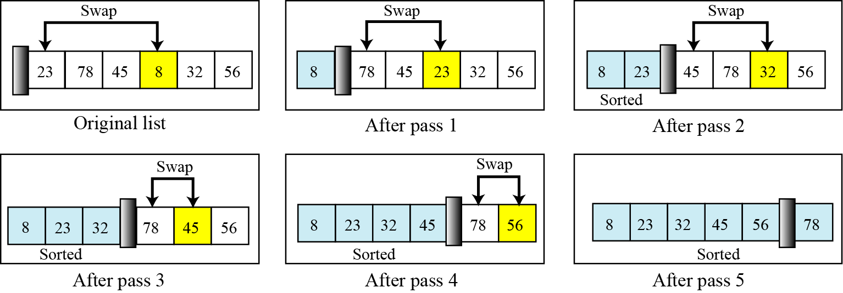
Selection Sort
Procedure:
Selection sort involved scanning through the list to find (or select) the smallest element and swap it with the first element.
The rest of the list is then search for the next smallest and swap it with the second element.
This process is repeated until the rest of the list reduces to one element, by which time the list is sorted.
The following table shows how selection sort works.

Slide 22
Example:
Elements in the array before swapping: 77 33 44 55 88 66 22 11
pass-1 11 33 44 55 88 66 22 77
pass-2 11 22 44 55 88 66 33 77
pass-3 11 22 33 55 88 66 44 77
pass-4 11 22 33 44 88 66 55 77
pass-5 11 22 33 44 55 66 88 77
pass-6 11 22 33 44 55 66 88 77
pass-7 11 22 33 44 55 66 77 88
pass-8 11 22 33 44 55 66 77 88
Elements in the array before swapping: 11 22 33 44 55 66 77 88

Slide 23
/* Write a c program to implement the selection sort*/
#include<stdio.h>
void select_sort(int x[], int size); void selection_sort(int,int);
int n,size,a[10],i,j,x,k,pass,temp,min,loc;
void main() {
printf("\nEnter the size of array: ");
scanf("%d",&n);
printf("\nEnter the array elements: ");
for(i=0;i<n;i++)
scanf("%d",&a[i]);
printf("\nElements in array before swapping: ");
for(i=0;i<n;i++)
printf("\t%d",a[i]);
printf("\n");
select_sort(a,n);
printf("\n\n\tElements after swapping: ");
for(i=0;i<n;i++)
printf("\t%d",a[i]);
getch();
}

Slide 24
void select_sort(int x[],int size)
{
for(k=0;k<n;k++)
{
loc = find_min(x,k,size);
temp=x[k];
x[k]=x[loc];
x[loc]=temp;
}
}
int find_min(int x[],int k,int size)
{
min=x[k];
loc=k;
for(j=k+1;j<=size-1;j++)
{
if(min>x[j])
{
min=x[j];
loc=j;
}
}
return loc;
}

Slide 25
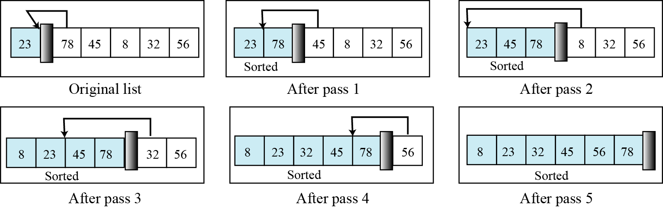
Insertion Sort
  Using insertion sort an element is inserted in correct location.
  Procedure:
  Begin with a sequence of n elements in arbitrary order
  Initially assume the sorted segment contains the first element.
  Let x be the next element to be inserted in sorted segment, pull x “out of the
  way”, leaving a vacancy.
  Repeatedly compare x to the element just to the left of the vacancy, and as long as x is smaller, move that element into the vacancy, else put x in the vacancy.
  Repeat the next element that has not yet examined.

Slide 26
Example:
Elements in array before swapping: 77 33 44 11 88 22 66 55
pass-1 77 33 44 11 88 22 66 55
pass-2 33 77 44 11 88 22 66 55
pass-3 33 44 77 11 88 22 66 55
pass-4 11 33 44 77 88 22 66 55
pass-5 11 33 44 77 88 22 66 55
pass-6 11 22 33 44 77 88 66 55
pass-7 11 22 33 44 66 77 88 55
pass-8 11 22 33 44 55 66 77 88
Elements in array after sorting: 11 22 33 44 55 66 77 88

Slide 27
/*Write a program to implement the insertion sort*/
#include<stdio.h>
void insertionsort(int a[],int size);
void main() {
int n,a[10],i,x;
printf("\nEnter the size of array: ");
scanf("%d",&n);
printf("\nEnter the array elements: ");
for(i=0;i<n;i++)
scanf("%d",&a[i]);
printf("\nElements in array before swapping: ");
for(i=0;i<n;i++)
printf(" %d",a[i]);
printf("\n");
insertionsort(a,n);
printf("\n\nElements in array after sorting: ");
for(x=0;x<n;x++)
printf(" %d",a[x]);
getch();
}

Slide 28
void insertionsort(int a[],int n)
{
int k,j,temp,x;
for(k=0;k<n;k++)
{
temp=a[k];
j=k-1;
while((j>=0)&&(temp<=a[j]))
{
a[j+1]=a[j];
a[j]=temp;
j=j-1;
}
}
}

Slide 29
Quicksort
In this method, an element called pivot is identified and that element is fixed in its place by moving all the elements less than that to its left and all the elements greater than that to its right.
Procedure:
If array only contains one element, return it.
Else
  Pick one element to use as pivot.
  Partition elements into two sub-arrays
    Elements less than or equal to pivot
    Elements greater than pivot
  Quicksort two sub-arrays.
  4. Return results.

Slide 30
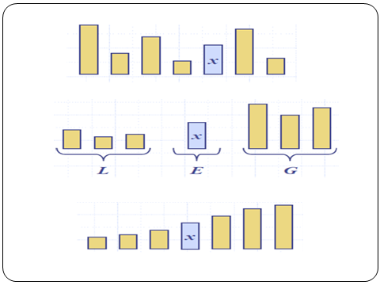

Slide 31
pivot_index = 0
40
20
10
80
60
50
7
30
100
[0] [1] [2] [3] [4] [5] [6] [7] [8]
i
j

Slide 32
While data[i] <= data[pivot]
++i
pivot_index = 0
40
20
10
80
60
50
7
30
100
[0] [1] [2] [3] [4] [5] [6] [7] [8]
i
j

Slide 33
While data[i] <= data[pivot]
++i
pivot_index = 0
40
20
10
80
60
50
7
30
100
[0] [1] [2] [3] [4] [5] [6] [7] [8]
i
j

Slide 34
While data[i] <= data[pivot]
++i
pivot_index = 0
40
20
10
80
60
50
7
30
100
[0] [1] [2] [3] [4] [5] [6] [7] [8]
i
j

Slide 35
While data[i] <= data[pivot]
  ++i
While data[j] > data[pivot]
  --j
pivot_index = 0
40
20
10
80
60
50
7
30
100
[0] [1] [2] [3] [4] [5] [6] [7] [8]
i
j

Slide 36
While data[i] <= data[pivot]
  ++i
While data[j] > data[pivot]
  --j
pivot_index = 0
40
20
10
80
60
50
7
30
100
[0] [1] [2] [3] [4] [5] [6] [7] [8]
i
j

Slide 37
While data[i] <= data[pivot]
  ++i
While data[j] > data[pivot]
  --j
If i < j
  swap data[i] and data[j]
pivot_index = 0
40
20
10
80
60
50
7
30
100
[0] [1] [2] [3] [4] [5] [6] [7] [8]
i
j

Slide 38
While data[i] <= data[pivot]
  ++i
While data[j] > data[pivot]
  --j
If i < j
  swap data[i] and data[j]
pivot_index = 0
40
20
10
30
60
50
7
80
100
[0] [1] [2] [3] [4] [5] [6] [7] [8]
i
j

Slide 39
While data[i] <= data[pivot]
  ++i
While data[j] > data[pivot]
  --j
If i < j
  swap data[i] and data[j]
While j > i, go to 1.
pivot_index = 0
40
20
10
30
60
50
7
80
100
[0] [1] [2] [3] [4] [5] [6] [7] [8]
i
j

Slide 40
While data[i] <= data[pivot]
  ++i
While data[j] > data[pivot]
  --j
If i < j
  swap data[i] and data[j]
While j > i, go to 1.
pivot_index = 0
40
20
10
30
60
50
7
80
100
[0] [1] [2] [3] [4] [5] [6] [7] [8]
i
j

Slide 41
While data[i] <= data[pivot]
  ++i
While data[j] > data[pivot]
  --j
If i < j
  swap data[i] and data[j]
While j > i, go to 1.
pivot_index = 0
40
20
10
30
60
50
7
80
100
[0] [1] [2] [3] [4] [5] [6] [7] [8]
i
j

Slide 42
While data[i] <= data[pivot]
  ++i
While data[j] > data[pivot]
  --j
If i < j
  swap data[i] and data[j]
While j > i, go to 1.
pivot_index = 0
40
20
10
30
60
50
7
80
100
[0] [1] [2] [3] [4] [5] [6] [7] [8]
i
j

Slide 43
While data[i] <= data[pivot]
  ++i
While data[j] > data[pivot]
  --j
If i < j
  swap data[i] and data[j]
While j > i, go to 1.
pivot_index = 0
40
20
10
30
60
50
7
80
100
[0] [1] [2] [3] [4] [5] [6] [7] [8]
i
j

Slide 44
While data[i] <= data[pivot]
  ++i
While data[j] > data[pivot]
  --j
If i < j
  swap data[i] and data[j]
While j > i, go to 1.
pivot_index = 0
40
20
10
30
60
50
7
80
100
[0] [1] [2] [3] [4] [5] [6] [7] [8]
i
j

Slide 45
While data[i] <= data[pivot]
  ++i
While data[j] > data[pivot]
  --j
If i < j
  swap data[i] and data[j]
While j > i, go to 1.
pivot_index = 0
40
20
10
30
7
50
60
80
100
[0] [1] [2] [3] [4] [5] [6] [7] [8]
i
j

Slide 46
While data[i] <= data[pivot]
  ++i
While data[j] > data[pivot]
  --j
If i < j
  swap data[i] and data[j]
While j > i, go to 1.
pivot_index = 0
40
20
10
30
7
50
60
80
100
[0] [1] [2] [3] [4] [5] [6] [7] [8]
i
j

Slide 47
While data[i] <= data[pivot]
  ++i
While data[j] > data[pivot]
  --j
If i < j
  swap data[i] and data[j]
While j > i, go to 1.
pivot_index = 0
40
20
10
30
7
50
60
80
100
[0] [1] [2] [3] [4] [5] [6] [7] [8]
i
j

Slide 48
While data[i] <= data[pivot]
  ++i
While data[j] > data[pivot]
  --j
If i < j
  swap data[i] and data[j]
While j > i, go to 1.
pivot_index = 0
40
20
10
30
7
50
60
80
100
[0] [1] [2] [3] [4] [5] [6] [7] [8]
i
j

Slide 49
While data[i] <= data[pivot]
  ++i
While data[j] > data[pivot]
  --j
If i < j
  swap data[i] and data[j]
While j > i, go to 1.
pivot_index = 0
40
20
10
30
7
50
60
80
100
[0] [1] [2] [3] [4] [5] [6] [7] [8]
i
j

Slide 50
While data[i] <= data[pivot]
  ++i
While data[j] > data[pivot]
  --j
If i < j
  swap data[i] and data[j]
While j > i, go to 1.
pivot_index = 0
40
20
10
30
7
50
60
80
100
[0] [1] [2] [3] [4] [5] [6] [7] [8]
i
j

Slide 51
While data[i] <= data[pivot]
  ++i
While data[j] > data[pivot]
  --j
If i < j
  swap data[i] and data[j]
While j > i, go to 1.
pivot_index = 0
40
20
10
30
7
50
60
80
100
[0] [1] [2] [3] [4] [5] [6] [7] [8]
i
j

Slide 52
While data[i] <= data[pivot]
  ++i
While data[j] > data[pivot]
  --j
If i < j
  swap data[i] and data[j]
While j > i, go to 1.
pivot_index = 0
40
20
10
30
7
50
60
80
100
[0] [1] [2] [3] [4] [5] [6] [7] [8]
i
j

Slide 53
While data[i] <= data[pivot]
  ++i
While data[j] > data[pivot]
  --j
If i < j
  swap data[i] and data[j]
While j > i, go to 1.
pivot_index = 0
40
20
10
30
7
50
60
80
100
[0] [1] [2] [3] [4] [5] [6] [7] [8]
i
j

Slide 54
While data[i] <= data[pivot]
  ++i
While data[j] > data[pivot]
  --j
If i < j
  swap data[i] and data[j]
While j > i, go to 1.
Swap data[j] and data[pivot_index]
pivot_index = 0
40
20
10
30
7
50
60
80
100
[0] [1] [2] [3] [4] [5] [6] [7] [8]
i
j

Slide 55
While data[i] <= data[pivot]
  ++i
While data[j] > data[pivot]
  --j
If i < j
  swap data[i] and data[j]
While j > i, go to 1.
Swap data[j] and data[pivot_index]
7
20
10
30
40
50
60
80
100
pivot_index = 4
[0] [1] [2] [3] [4] [5] [6] [7] [8]
i
j

Slide 56
Partition Result
7
20
10
30
40
50
60
80
100
[0] [1] [2] [3] [4] [5] [6] [7] [8]
<= data[pivot]
> data[pivot]

Slide 57
Recursion: Quicksort Sub-arrays
7
20
10
30
40
50
60
80
100
[0] [1] [2] [3] [4] [5] [6] [7] [8]
<= data[pivot]
> data[pivot]

Slide 58
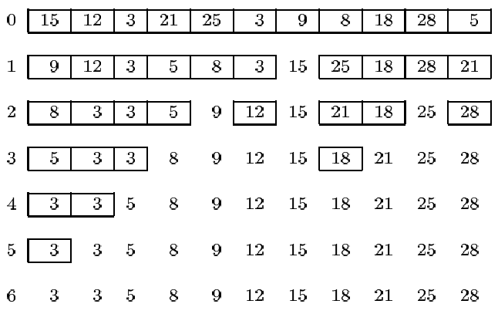
Recursive implementation with the left most array entry selected as the pivot element.

Slide 59
/*Write a c program to implement the quick sort*/
#include<stdio.h>
void quicksort(int [10],int,int);
int main(){
int x[20],size,i;
printf("\nEnter size of the array: ");
scanf("%d",&size);
printf("\nEnter %d elements: ",size);
for(i=0;i<size;i++)
scanf("%d",&x[i]);
quicksort(x,0,size-1);
printf("\nSorted elements: ");
for(i=0;i<size;i++)
printf(" %d",x[i]);
getch();
return 0;
}

Slide 60
void quicksort(int x[10],int first,int last){
int pivot,j,temp,i;
if(first<last){
pivot=first; i=first; j=last;
while(i<j){
while(x[i]<=x[pivot]&&i<last)
i++;
while(x[j]>x[pivot])
j--;
if(i<j){
temp=x[i]; x[i]=x[j]; x[j]=temp;
}
}
temp=x[pivot];
x[pivot]=x[j];
x[j]=temp;
quicksort(x,first,j-1);
quicksort(x,j+1,last);
}
}

Slide 61
Merge Sort
In this method, the elements are divided into partitions until each partition has sorted elements.
Then, these partitions are merged and the elements are properly positioned to get a fully sorted list.
Procedure/Algorithm:
1. Split array A[0..n-1] into about equal halves and make copies of each half in
arrays B and C.
2. Sort arrays B and C recursively.
3. Merge sorted arrays B and C into array A as follows:
  3.1. Repeat the following until no elements remain in one of the arrays:
    3.1.1 Compare the first elements in the remaining unprocessed portions of the arrays.
    3.1.2 Copy the smaller of the two into A, while incrementing the index indicating the unprocessed portion of that array.
    3.2 Once all elements in one of the arrays are processed, copy the remaining unprocessed elements from the other array into A.

Slide 62
Example 1:
mergesort(a,0,7)
8
3
2
9
7
1
5
4
mergesort(a,0,3)
mergesort(a,4,7)
8
3
2
9
7
1
5
4
mergesort(a,0,1)
mergesort(a,2,3)
mergesort(a,4,5)
mergesort(a,6,7)
8
3
2
9
7
1
5
4
ms(a,0,0)
ms(a,1,1)
ms(a,2,2)
ms(a,3,3)
ms(a,4,4)
ms(a,5,5)
ms(a,6,6)
ms(a,7,7)
8
3
2
9
7
1
5
4
merge(a,0,1,0)
merge(a,2,3,2)
merge(a,4,5,4)
merge(a,6,7,6)
3
8
2
9
1
7
4
5
merge(a,0,3,1)
merge(a,4,7,5)
2
3
8
9
1
4
5
7
merge(a,0,7,3)
1
2
3
4
5
7
8
9

Slide 63
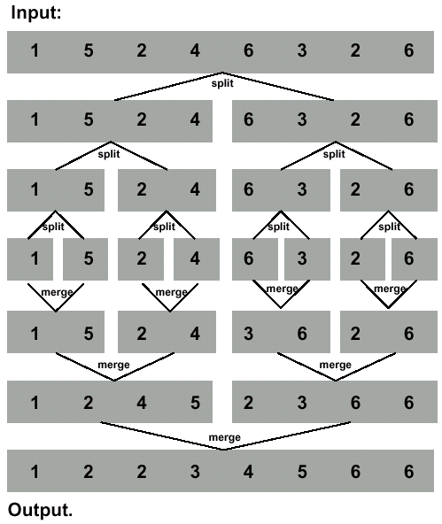
Example 2:

Slide 64
/*Program for merge sort*/
#include <stdio.h>
#include <conio.h>
void main()
{
int i,n,a[100];
clrscr();
printf("\n Enter the size of the array :");
scanf("%d",&n);
printf("\n Enter the elements :\n");
for(i = 0; i < n; i++)
scanf("%d",&a[i]);
mergesort(a,0,n-1);
printf("\n Elements in sorted order :\n");
for(i = 0; i < n; i++)
printf("%5d",a[i]);
getch();
}

Slide 65
void merge(int a[],int l,int h,int m) {
int c[100],i,j,k;
i = l; j = m + 1; k = l;
while(i <= m && j <= h) {
if(a[i] < a[j]) {
c[k] = a[i];
i++; k++;
}
else {
c[k] =a[j];
j++; k++;
}
}
while(i <= m)
c[k++] = a[i++];
while(j <= h)
c[k++] = a[j++];
for(i = l; i < k; i++)
a[i] = c[i];
}
void merge(int [],int,int,int);
void mergesort(int a[],int low,int high)
{
int mid;
if(low < high)
{
mid = (low + high)/2;
mergesort(a,low,mid);
mergesort(a,mid+1,high);
merge(a,low,high,mid);
}
}

Slide 66
Big O Notation
  Indicates, how hard an algorithm has to work to solve a problem.
Time Complexities of Searching & Sorting Algorithms:
 | Best Case | Average Case | Worst Case
Linear Search | O(1) | O(n) | O(n)
Binary Search | O(1) | O(log n) | O(log n)
Bubble Sort | O(n²) | O(n²) | O(n²)
Selection Sort | O(n²) | O(n²) | O(n²)
Insertion Sort | O(n²) | O(n²) | O(n²)
Merge Sort | O(n log n) | O(n log n) | O(n log n)
Quick Sort | O(n log n) | O(n log n) | O(n²)

